Slide 1
The Security Landscape & Controlling Computers

Slide 2
Today’s Plan
The Security Landscape (Elementary Information Security, Chapter 2)
Controlling a Computer
Programs and Processes
Buffer Overflow and the Morris Worms
Access Control Strategies
Keeping Processes Separate
Lab 2: Learning Shell Scripting in Linux

Slide 3

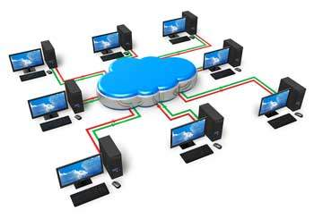
The Security Landscape

Slide 4




The Security Landscape
From security in a personal computer to problems in networks.
Trade-off between security and benefits of ownership.
Security choices fall into three categories:
Rule-based decisions
Relativistic decisions
Rational decisions
Notes:
-What’s the point of owning and securing a computer if you cannot enjoy it?
-Rule-based: due to external circumstances i.e. car ignition lock since it comes by default
-Relativistic: outdo others i.e. hunter’s dilemma, to escape from danger you have to run faster than others
-Rational: Systematic analysis i.e. the security process

Slide 5


The Security Process
Six steps:
Identify your assets.
Analyse the risk of attack.
Establish your security policy.
Implement your defences.
Monitor your defences.
Recover from attacks.
Features shared:
Planning
Trade-off analysis
Verification
Iteration
Moreover, it ensures that we have systematically reviewed the risks.
$$\}$$
Early stages
$$\}$$
Later stages
Notes:
-Step 6 builds upon the previous 5!
-Only relying on rule and relativistic decisions makes people assume we all face the same risks i.e. not using pen drives in companies makes sense, but not so much in universities.
-Bob’s PC (page 7) example of the security process

Slide 6
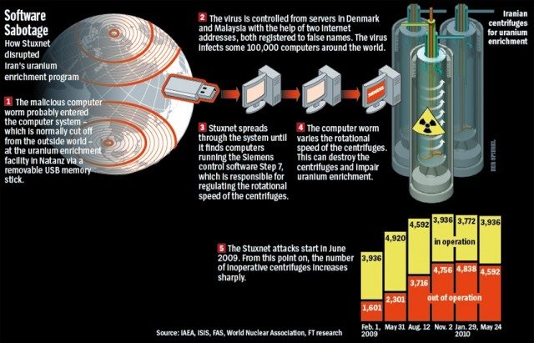
https://www.extremetech.com/computing/200898-windows-pcs-vulnerable-to-stuxnet-attack-five-years-after-patches

Slide 7

Controlling a Computer
Notes:
-All computer programmes can be reduced to a set of simple mathematical instructions.
-Controlling the ACCESS to a computer.
-Keeping the computer under control.

Slide 8
Motherboard
CPU
RAM
BIOS
I/O Connectors
https://upload.wikimedia.org/wikipedia/commons/thumb/9/9d/Acer_E360_Socket_939_motherboard_by_Foxconn.svg/2000px-Acer_E360_Socket_939_motherboard_by_Foxconn.svg.png
Notes:
-CPU is in charge of running all programmes.
-PCI slot or daughterboard hold RAM.
-The rest of the board is filled with I/O connectors, such as busses (USB, IDE, ATA, SATA, PCI), Ethernet and video connectors (DVI, VGA).
-BIOS

Slide 9
Program Execution
A program counter (PC) in the CPU keeps track of where a program’s next instruction resides.
To execute a program, the CPU:
Retrieves the instruction from the RAM.
Performs it.
Updates PC to the point of the next instruction.

Slide 10
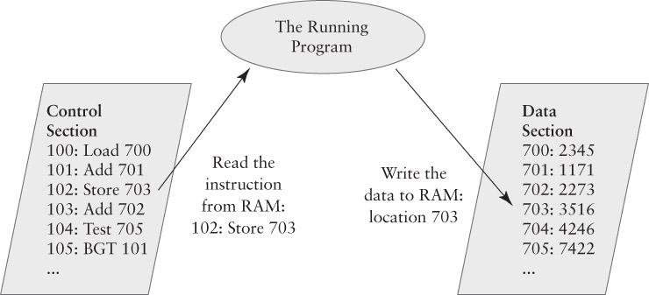
Program Execution
RAM is divided into control and data sections.
Access errors are due to programming errors or security issues.
Each section is one byte (enough for a keyboard stroke but not for a command).
Instruction must allocate enough space for address.
Stacks and buffers also help.

Slide 11
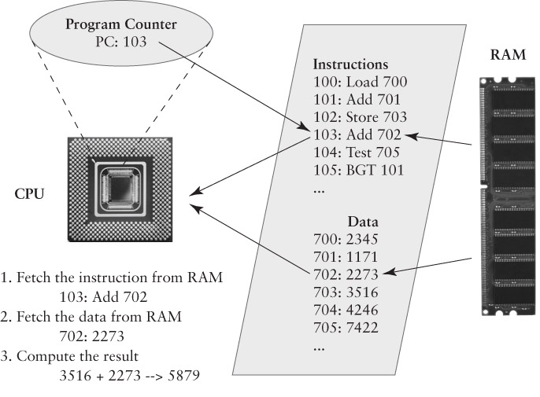
Program Execution
After running instructions 100 (load 2345), 101 (2345+1171=3516) and 102 (store 3516 in data section 703), the state of a program is the following:
3516
What happens next?
Notes:
-Instruction 100 loads data from register 700 (2345).
-Instruction 101 adds that to data in register 701 (2345+1171 = 3516)
-Instruction 102 stores 3516 in data register 703.
-Step 4 would be executing instruction 104, since the PC didn’t changed!
-However, some programs are able to do so by using operations such as if, for, while, etc.

Slide 12
Programs and Processes

Slide 13
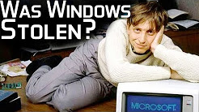
Operative Systems and Shells
Typically a user wants to run more than one program at a time.
The OS is in charge of interpreting the inputs (i.e. mouse clicks, keyboard strokes) and assigning them to different programs.
Moreover, an OS such as Windows or Linux count with a shell (i.e. MS-DOS).
Meaning of MS-DOS?
The shell has its own commands, which are executed directly by the OS.
Notes:
MSDOS: MicroSoft Disk Operating System or MicroSoft Dirty Operating System (https://www.youtube.com/watch?v=sDIK-C6dGks&t=392s). It originally was the OS.

Slide 14
Programs and Processes
A program is a group of instructions.
A process is a running program.
PC is, or can be, changing between processes.
Each process has some RAM with instructions and data.
Windows example:
Run two command shells.
One program, two processes.
Looking at processes with the Task Manager (in MacOS/Linux, $ps).
Notes:
-You can run Word twice!

Slide 15
Switching processes
The “dispatcher” procedure in the OS switches between running processes.
Stops (pauses) one process and starts another:
Save the PC for the stopped process.
Save other CPU data from the stopped process.
Locate the “saved state” for the one to start.
Load up the saved CPU data for the process.
Load the PC with the starting process’ PC value.
Parallelism illusion.

Slide 16
Buffer Overflows and the Morris Worm

Slide 17
Backdoors
Cleverly designed messages that crash a software due to flaws in the network.
Provide a connection by which an attacker can take control of the computer.
Simplest case: Control of the command shell.
1988: Robert T. Morris wrote a program that could replicate itself across computers connected to the internet (60’000 computers) by exploiting the finger service (Unix).

Slide 18


How could the worm fit on a floppy disk?
Mountain View, California
Notes:
It exploited a very “dumb” vulnerability!

Slide 19
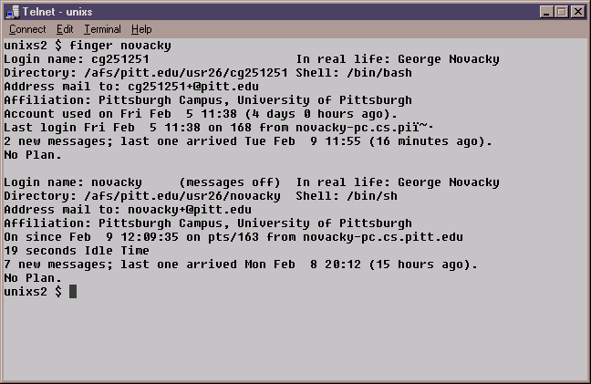
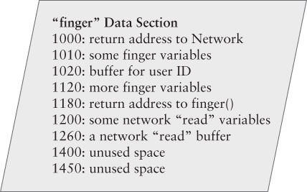
The Finger Protocol
Purpose: Report status of individual computer users.
Example: By typing finger jsl@bu.edu, the command starts a program that contacts the finger server bu.edu and asks about user jsl.
Server responds if user is currently logged in, when last logged in, address, phone no., etc.
1020-1120: 100-byte buffer to store the user ID.
Finger didn’t check the size in advance
Notes:
-Like a ping but in a directory
-Instead of using one register per instruction like in the toy example, here there is a 100 byte buffer between instructions.
-They key to understand finger overflow is register 1020. It only assigns 100 bytes for user id!

Slide 20
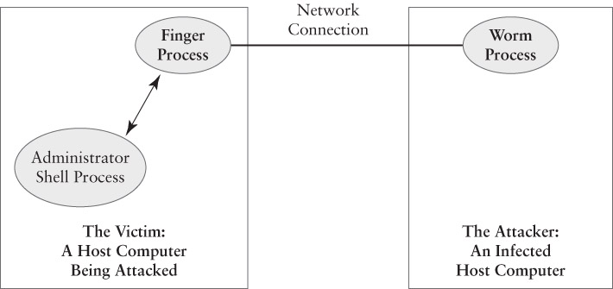
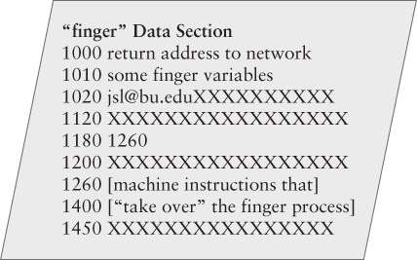
Finger (Stack) Overflow
Normal
If the sender typed to many letters, the program overflowed the buffer.
Malicious
Notes:
-Since the finger process didn’t check the size of incoming data, it copies the data into RAM past of the end of the buffer’s assigned space.

Slide 21
Overflow data content
Understand how the finger service uses RAM to save PCs.
The worm has two essential components:
Sequence of computer instructions (shellcode).
A storage location with the return address for the network read function.
Commands like “cmd” on windows to start shell unsuspectedly.
Once read finishes, it tries to return its caller by using the address stored at 1180, but the overflow rewrote that to 1260 (malicious code).
Taken from attacking host computer
Notes:
For 1 (from 1260 until 1450)
-Commands like “cmd” on Windows to start the shell unsuspectedly.
-The commands are taken from the attacking host computer, not from the keyboard. These travel over the same connection used for the finger service.
For 2 (1180)
-The overflow data overwrote the return address.
-Once the read function finished, it tried to return its caller by using the address stored at 1180, but the overflow rewrote that to 1260.
In the case of the Morris worm, the commands installed the worm in the attacked computer.

Slide 22
Why this worked?
CPU could not distinguish between instructions and data in the RAM.
Otherwise it wouldn’t execute the malicious shellcode instructions.
Microsoft has a data execution prevention (DEP) feature to avoid this.
It’s not default, applications have to specify it.
The finger process ran with root privileges.
You could downgrade it, but it was “easier” this way (no trade-off analysis!).
Most people used C, which doesn’t provide boundary checking.
Java automatically checks, but people still use C.
Modern C libraries allow buffer overflow check, but they are rarely implemented.

Slide 23
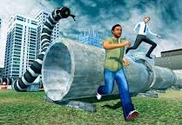
The Worm
Released in October 1988.
Promptly infected 10% of Internet computers:
The worm was designed to infect each computer once.
This restricting code did not work.
Each computer was infected hundreds of times!
Infected computers became unusable.
Spread US-wide between 9pm and 11pm.

Slide 24
Fighting the Worm
Telephone lines were not affected.
Analysts shared information by phone.
Many affected were meeting at Berkeley University.
As computers were cleaned, they shared status and defensive data via email:
A ‘clean’ computer had to be hardened against the worm or it would be infected all over again.

Slide 25
Aftermath
The worm incident helped create the Computer Emergency Response Team (CERT).
First US-wide, multi-organization computer security team.
Track and report problems.
Today, reports are tracked by the Common Vulnerability Enumeration (CVE).
Numerous public and private security organizations, like the “Internet Storm Center”.
Watch internet traffic and look for disruptions.

Slide 26
Access Control Strategies
For processes

Slide 27

Type 1: Islands
Isolation and mediation.
All processes begin in their own island.
Done especially on potentially hostile processes.
Notes:
-Each process gets assigned resources to its island.

Slide 28
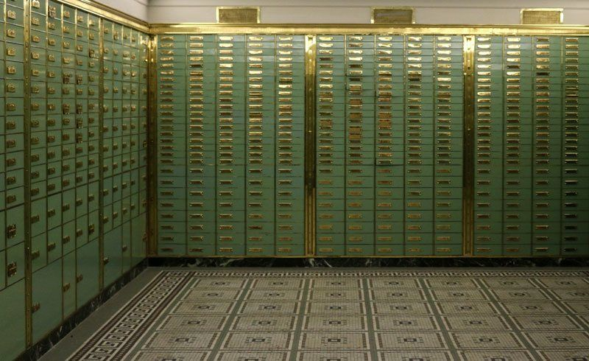
Type 2: Vaults
Often OS provides access for processes (including “islanders”) to computer resources.
Each request is checked by the OS.
Access to RAM is of particular importance.
Notes:
-Swiss bank vault

Slide 29



Type 3: Puzzles
Cryptography
Steganography
Security through obscurity (STO):
Hiding info (for good or bad purposes).
Cripto becomes STO when easy to hack!
Steg becomes STO when easy to look for!
Example of STO: Instead of addressing a security issue, threatening to sue the person that found it.

Slide 30
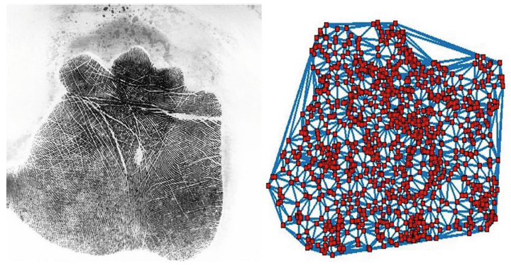
Type 4: Patterns
Very common but unreliable.
A computer antivirus recognises malware through comparison.
Biometrics compare patterns.
Main problem: balance between false positive and false negative rate.
Not effective against new threats.
Notes:
-In an application for the military, you rather have large false negatives (one false positive is a security breach).
-in contrast, in a gym door you can allow to have more false positives to reduce the false negatives and thus, have les cue.

Slide 31
Principle 1: Open Design
Opposite of STO.
Open the system for third-party analysis to help ensure its effectiveness:
“More eyes make bugs shallow” – Eric Raymond.
Kerckhoff’s Principle and crypto-design:
The crypto system can be well-known, but NOT the key used!
“The enemy knows the system” – Claude Shannon.

Slide 32
Principle 2: Chain of Control
We must never run programs that violate or bypass our security policy. To avoid this, we:
Start the computer using a BIOS that maintains our security policy.
If the software we start (i.e. the OS) can start other software, then the other software either
Complies with the security policy, OR
Is constrained from violating the policy via access restrictions or other mechanisms.

Slide 33
Subverting the Chain of Control
At the BIOS, attacker may:
“Boot” a different OS from a CD-ROM or a USB drive.
The new OS doesn’t enforce access restrictions.
Inside the OS, attacker may:
Install a privileged (administrative) program that can bypass access restrictions.
Trick an authorized user into leaking sensitive files.
Solution: Password protect BIOS user interface.
Worth it?
Notes:
-When a computer starts, it runs the BIOS (motherboard). There is an option to open the BIOS interface (ESC button).
-The interface loads the bootstrap device (where the BIOS loads the OS, typically the hard drive).
-If the bootstrap device is not found, then the BIOS will look in other storage units, such as CD-ROM or USB.

Slide 34
Keeping Processes Separate

Slide 35

Keeping Processes Separate
Operator errors and software bugs also pose threats to the computer.
Relies on hardware and software.
Hardware by providing special features to the CPU:
Two modes to distinguish between user and special (kernel) applications.
RAM restriction.
Software by including features in the OS:
User identities
Program Dispatcher
Memory Manager
RAM Protection
Window-oriented interface
In a 90’s OS, a damaged Word file could also damage an Excel spreadsheet. This was largely due to programs getting larger and occupying RAM registers which originally didn’t belong to them.

Slide 36
Hardware Separation using Program Modes
Kernel or Supervisor Mode
For highly privileged operating system programs with full CPU access.
Allows full access to RAM.
Dangerous! Used as rarely as possible.
User Mode
For most programs and all applications.
CPU blocks any attempt to use kernel mode instructions.

Slide 37
Hardware Separation using RAM Restriction
Each process operates in its own RAM island implemented through a page tabler that allocates RAM (a table per process).
Memory error when CPU finds a RAM register that doesn’t match the one assigned to the process.
Page tabler also specifies if the process is allowed to read/write or only read in a specific RAM register (CPU can read/write any register in kernel mode).

Slide 38

Software Separation through User Identities
OS provides the vault for each process.
Users are assigned a user ID.
Each user ID has specific resources (i.e. printer).
OS checks the permissions before granting access.

Slide 39
Any Exceptions?
Memory saving: Two processes running the same program.
Networking software: Several processes pass network data using the same RAM buffer.
Sharing data between processes (data section only).
If one process changes the control section while the other is running, a problem can occur.
Solution: OS restricts access to the control section. This is known as a read only access restriction.
Access rights are best represented through an Access (Lampson’s) Matrix.

Slide 40
Example 1
Process 1
Control
Section
Process 2
Process 1
Data Section
Process 2
Data Section
RAM | Process 1 | Process 2 | OS
Control Section | R- | R- | RW
Process 1 Data Section | RW | -- | RW
Process 2 Data Section | -- | RW | RW
Notes:
-Arrows indicate data flow between processes and resources.
-Control section is read-only.
-Windows are output devices.
-Processes can read/write the data section (data flows both ways). Each process has its own data section.
-In the access matrix, P1 and P2 can only read the control section and read/write their respective data section. OS can do anything.

Slide 41
Sharing Data
How to allow two processes to share data stored in RAM?
Normally processes are isolated from each other.
This prevents one process from damaging the other one.
OS provides a separate data section:
Processes still have exclusive access to own data.
All shared data resides in this separate section.
Both processes have RW access to the shared section.

Slide 42
Example 2: Sending Data to Pinter
OS acquires a data section to share.
Program Control Section
2. Program produces data to print.
3. Data to print is sent to the data buffer.
Program
4. When buffer is full, OS notifies printer process, which retrieves data from buffer and sends it to the printer.
Program Data Section
Shared Data Buffer
Printer Driver Control Section
Printer Driver
Printer Driver Data Section
Notes:
Every time the two sections and arrows appear, a process is being carried out.

Slide 43
Access Matrix Example 2
Control/Data Section | Program | Printer Driver | OS
Program Control Section | R- | -- | RW
Program Data Section | RW | -- | RW
Driver Control Section | -- | R- | RW
Driver Data Section | -- | RW | RW
Shared Data Buffer | RW | RW | RW
Driver is only granted the access it really needs.
Blue screen: Windows finds a fatal error and displays text mode and prints CPU and RAM contents.
Many of these problems result due to faulty device drivers (people who write drivers rarely know OS rules).
Notes:
-Program cannot touch driver’s sections and vice versa.
-Program and driver can read their control sections but not write on them.
-Program and driver can read and write on their data sections and in the shared data buffer.
-OS can do everything.

Slide 44
“Lab” 2: Learning Shell Scripting in Linux
Go to linuxcommand.org.
Go through section Learning the Shell.
To test the commands, you can use your VM!
Further information and practice can be found on “The Linux Command Line” book (PDF is on Moodle).

Slide 45
Lab 3: Writing Shell Scripts
ADDITIONAL PRACTICE
Writing Shell Scripts in linuxcommand.org.
“The Linux Command Line” book (PDF is on Moodle).

